Slide 1
COMMONWEALTH OF AUSTRALIA
Copyright Regulations 1969
WARNING
This material has been reproduced and communicated to you by or on behalf of the SAE Institute Pty Ltd pursuant to Part VB of the Copyright Act 1968 (the Act).
The material in this communication may be subject to copyright under the Act. Any further reproduction or communication of this material by you may be the subject of copyright protection under the Act.
Do not remove this notice.

Slide 2
GPG and GDS
Unreal Engine
import and migrate assets
Cliff Sharif
c.shariff@sae.edu

Slide 3
Unreal Engine project may have variety of assets. These assets in general are made by designers (like material, mesh, texture, animation, widget .. ) or are developed by coders (like blueprint components, state machines, AI implementations, widget .. ).
As you progress on project, you will need to communicate with source control and update your project to latest version all the time which means, some assets need to be updated as well.
When you need to add or remove new assets and organise the relation between them before update source, you may experience difficulties in cases of file size and unused assets.

Slide 4
-- standard practice in industry --
Working on a ”Local version” of your project,
import your assets there and make your design/code by using them and after you are done,
“migrate” your latest updates, to “source” version.
Lets check these steps ….

Slide 5
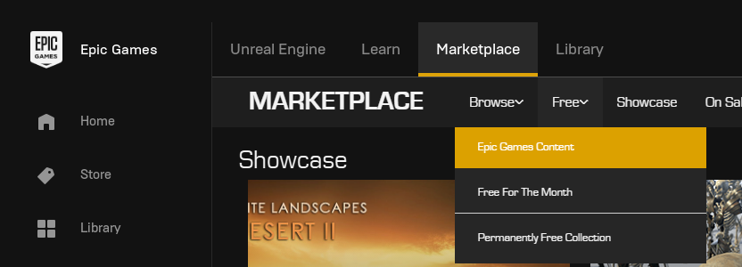
Assume we have a local and source projects and we like to download and add asset to source. Click on “Marketplace” and then choose “Epic Games Content” and then choose free assets.

Slide 6
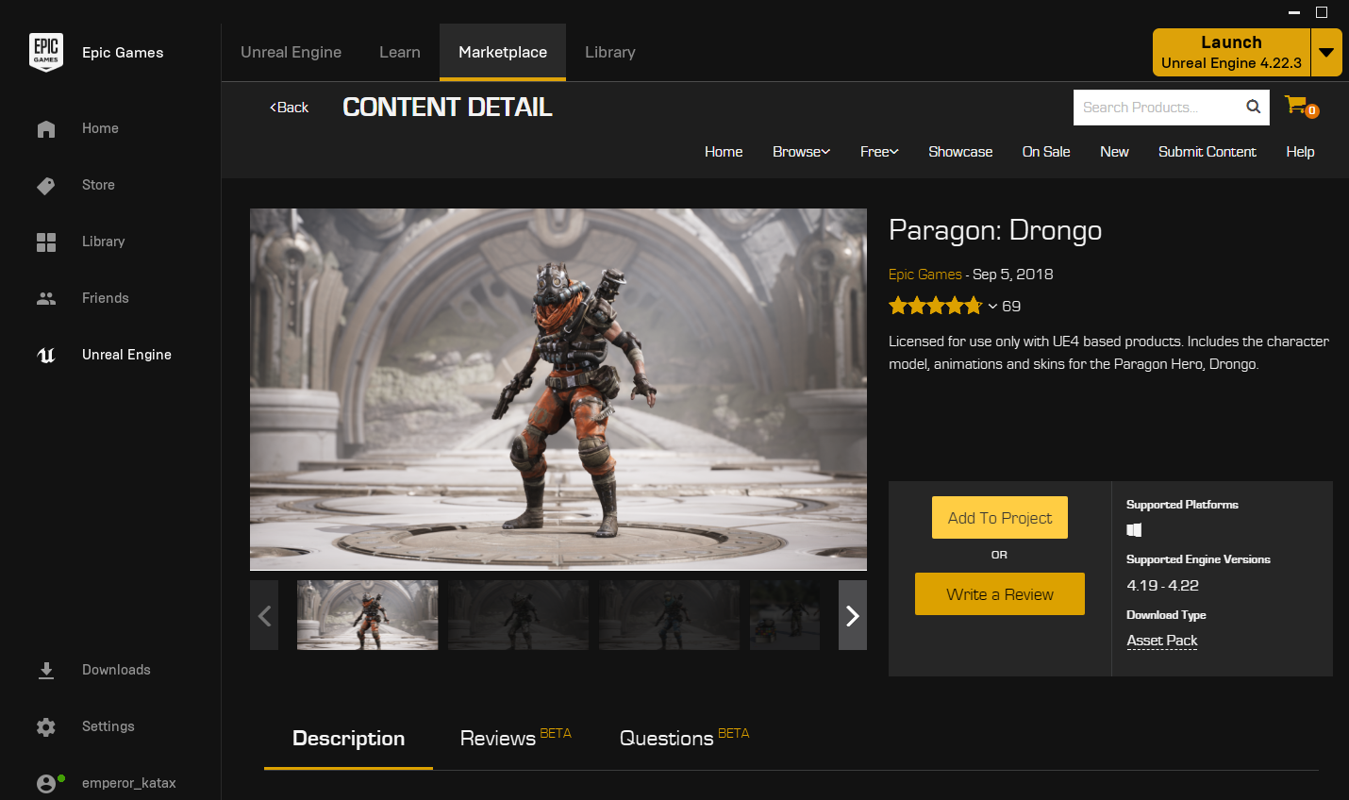
Now choose “Add To Project”

Slide 7
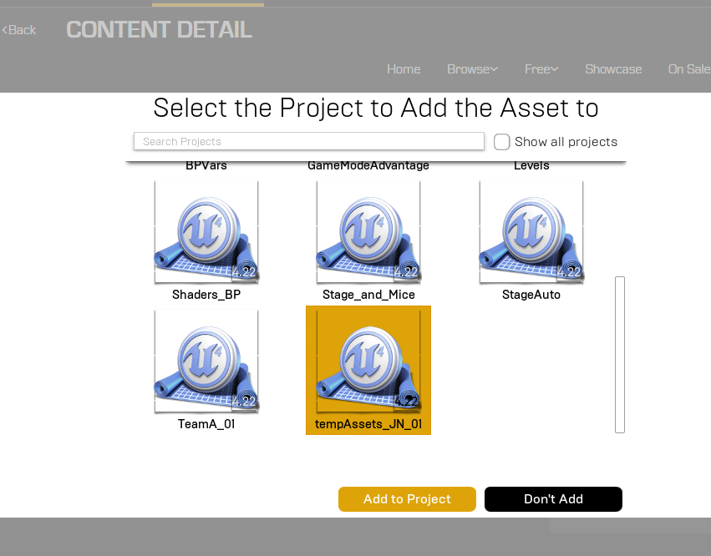
Then select your “Local” project and press “Add to Project”

Slide 8
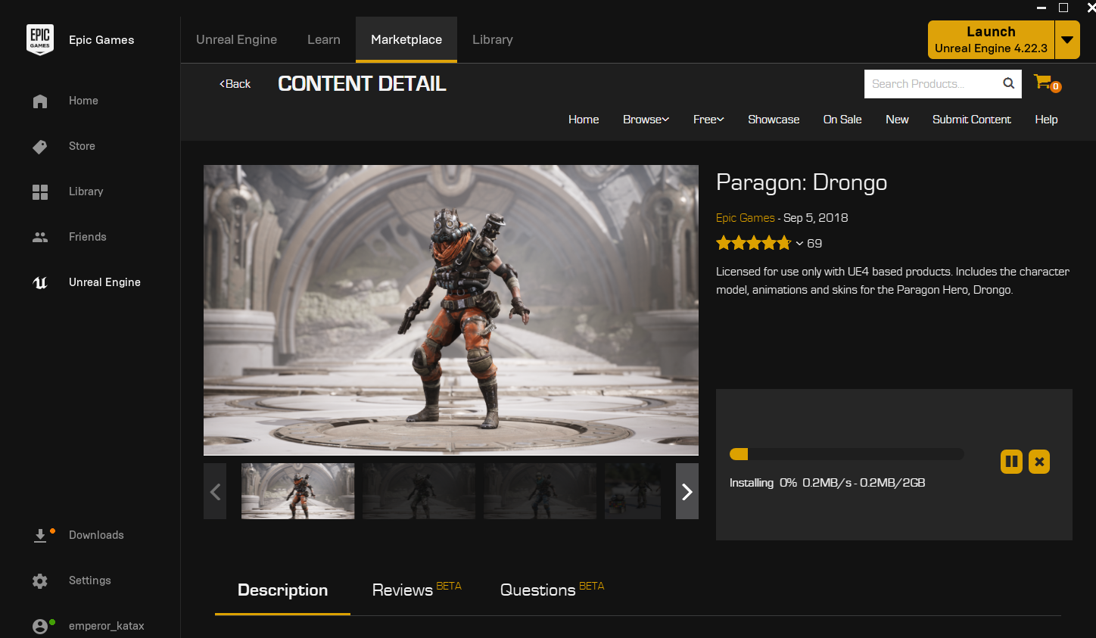
Epic Games Launcher download and will add selected assets to your project. This may take a while.

Slide 9
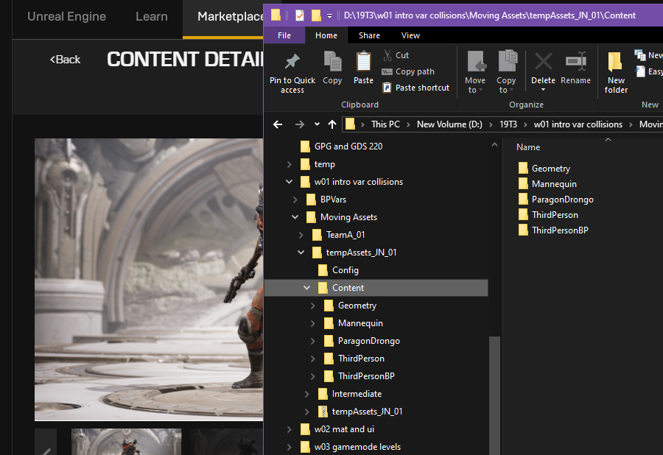
Assets will be add to “Content” folder after download finished and you will find them in a folder, which match to the asset`s title.

Slide 10
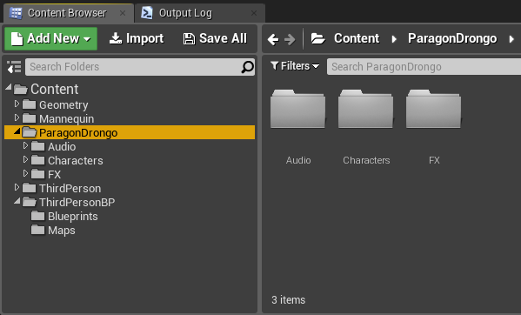
Open the local project, you will find this folder in content folder.

Slide 11
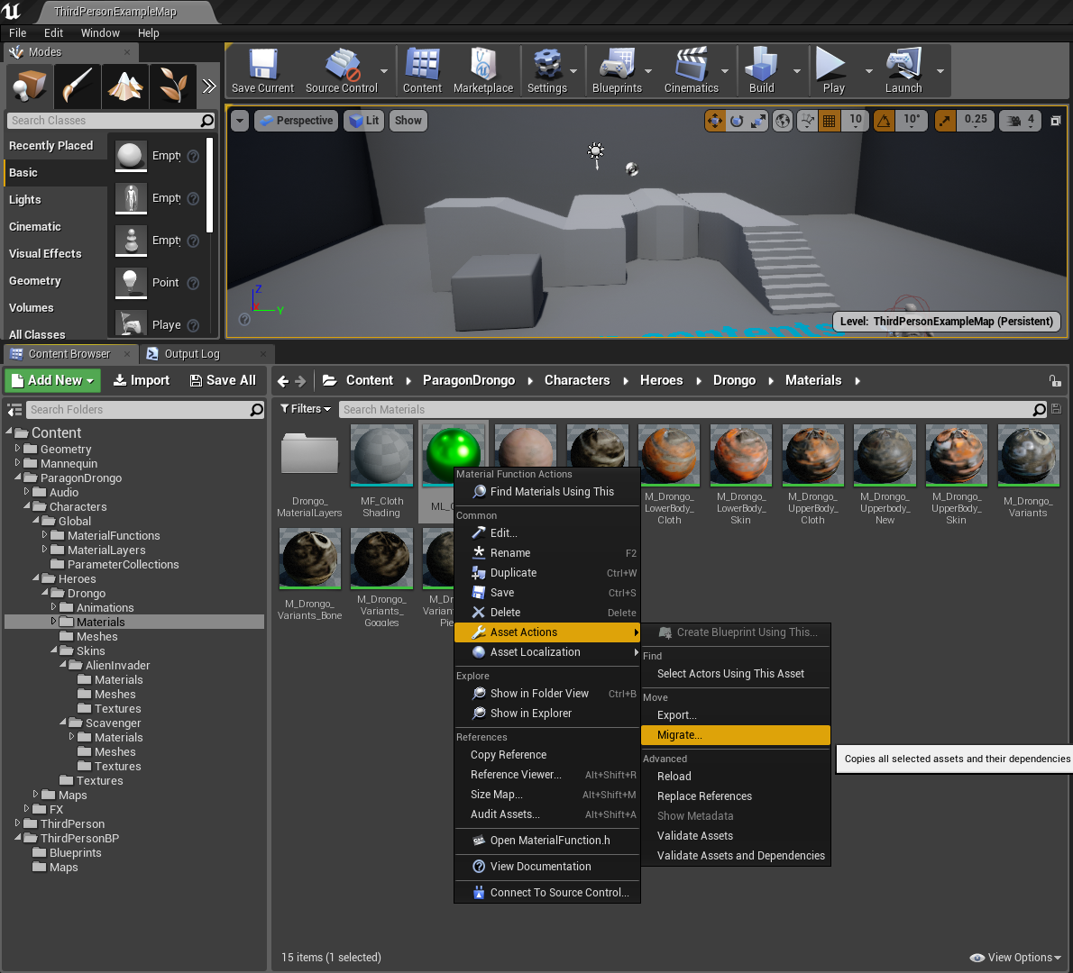
Now we like to copy an asset from
local project to source project. Choose and right click on an asset, and select “Migrate”
from
“Asset Actions”.

Slide 12
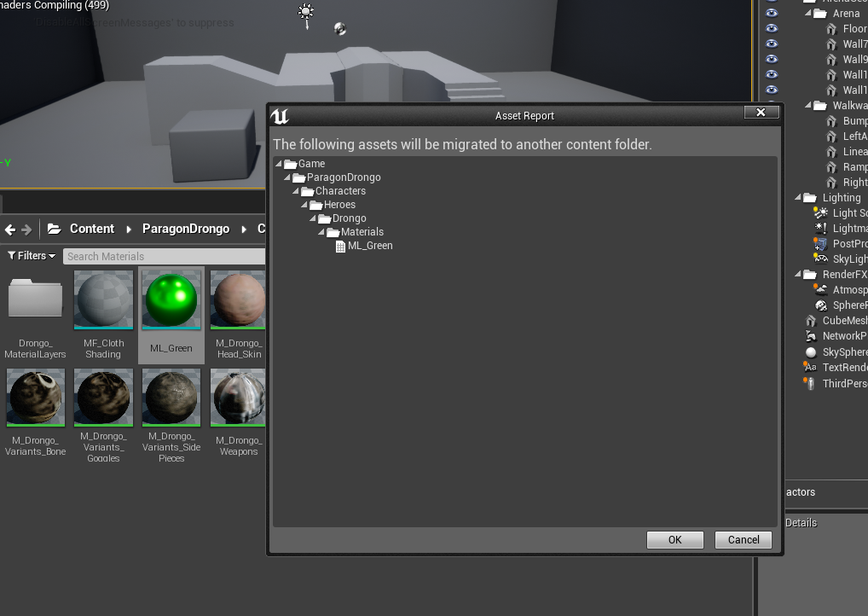
After select “Migrate”, Unreal Editor will show a list of involved materials & objects (& more…) with your selected asset.

Slide 13
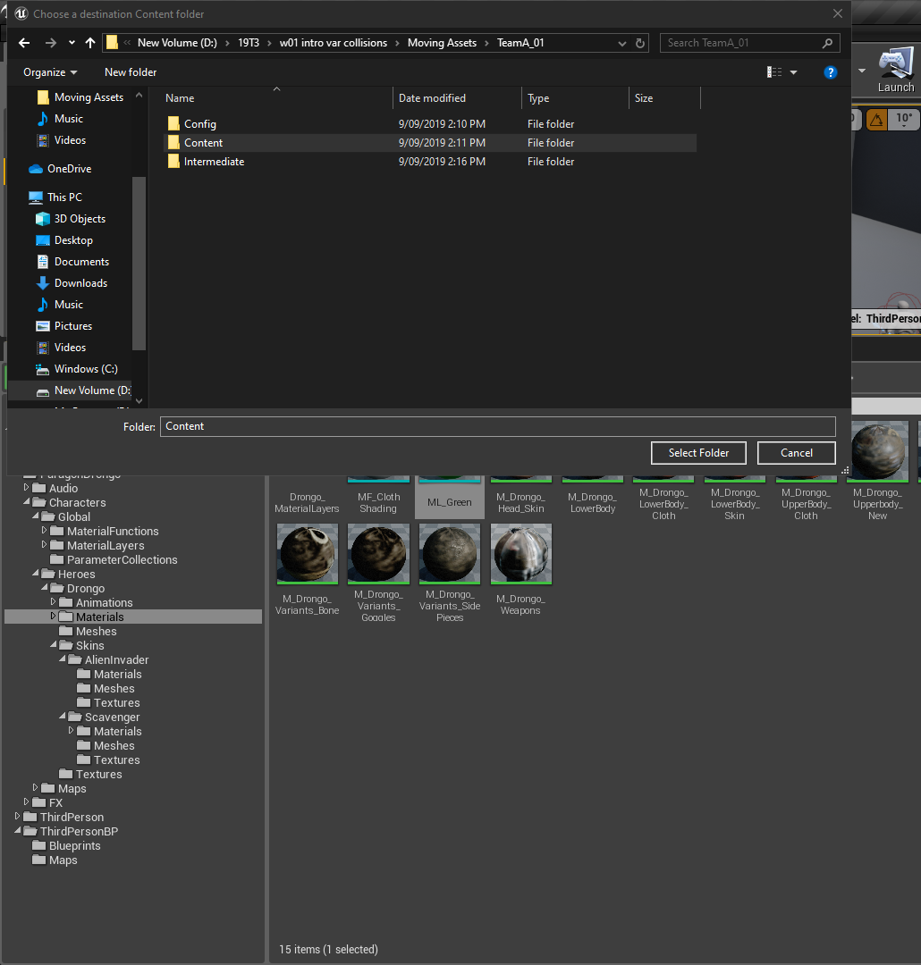
By press “OK” on previous step, you will prompt to select a folder as path which “MUST” be, content folder in your source project as a path for migrating assets.

Slide 14
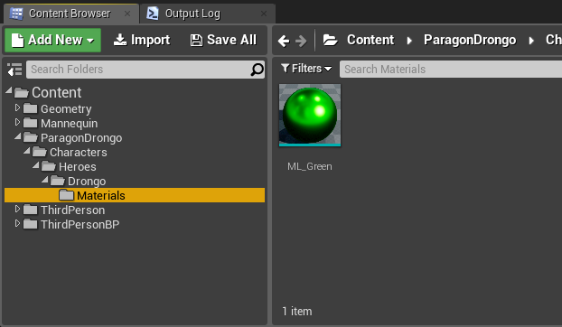
Now open source project and check your assets.
You can change location of this assets based on your needs.

Slide 15
References:
https://docs.unrealengine.com/en-US/Engine/Content/Browser/UserGuide/Migrate/index.html
https://www.youtube.com/watch?v=vUYiK1CkqBc
http://shootertutorial.com/2015/06/03/tip-how-to-move-assets-from-examples-different-projects/

